Slide 1

Agentic
Observability
Build an AI Agent That Tells You What Broke,
Who Owns It, and How to Fix It
Hands-on Workshop Session
Powered by LangSmith

Slide 2
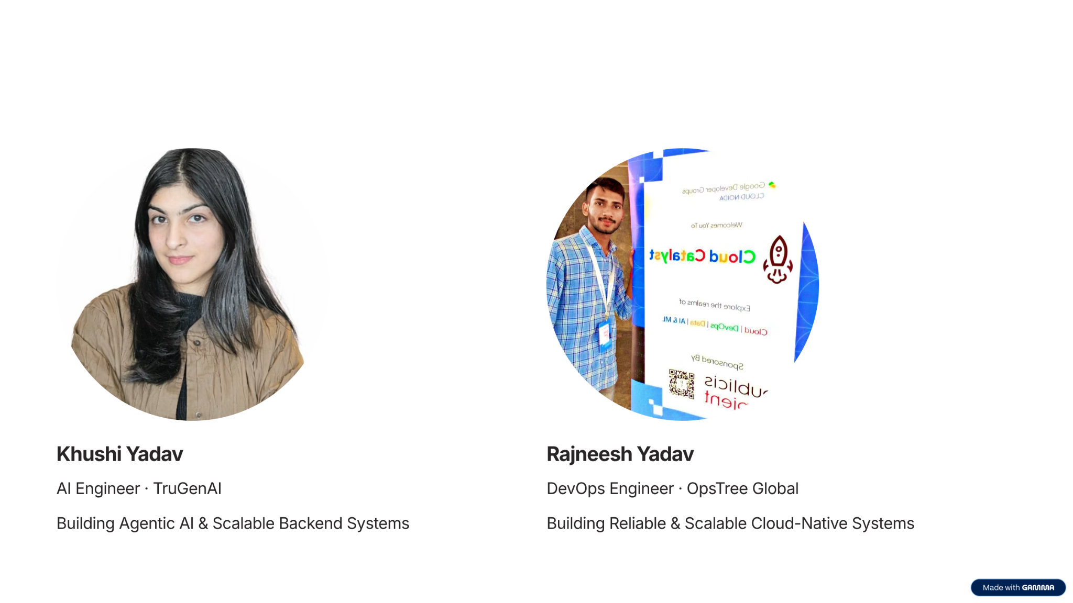
Meet the Speakers

Slide 3



What is Agentic Observability?
An AI-powered observability layer that autonomously detects, diagnoses, and assigns ownership of failures across your agent pipeline.
Detect
Diagnose
Resolve
AI agent monitors traces, logs, and metrics in real-time — identifies anomalies before users report them
Automatically traces failure root cause across LLM calls, tool executions, and retrieval pipelines
Maps failures to owning teams, suggests fixes, and generates actionable incident reports

Slide 4
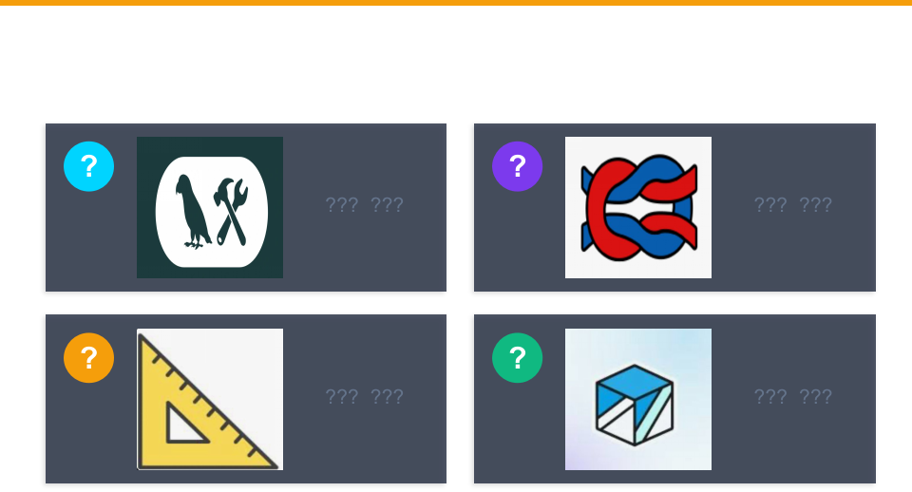

Slide 5
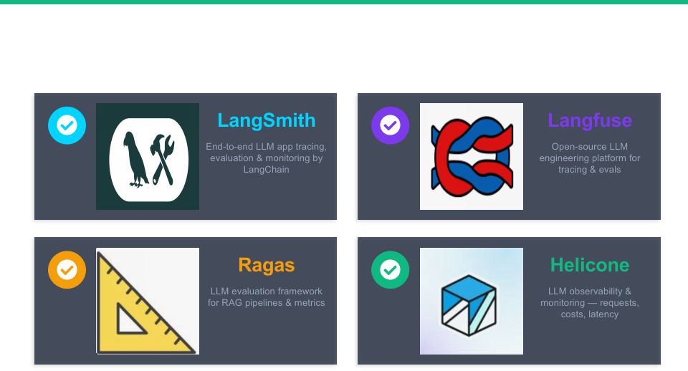

Slide 6





Agentic Observability Architecture
AI Agent
Execution
LangSmith
Tracing
Observability
Agent
Root Cause
Analysis
Incident
Report
How It Works End-to-End
1. Agent executes tasks — each LLM call, tool use, and retrieval is instrumented
2. LangSmith captures full execution traces with latency, token usage, and outputs
3. Observability agent analyzes traces in real-time for anomalies and failures
4. On failure — agent traces root cause, identifies responsible component/team
5. Generates incident report with fix suggestions and ownership assignment

Slide 7
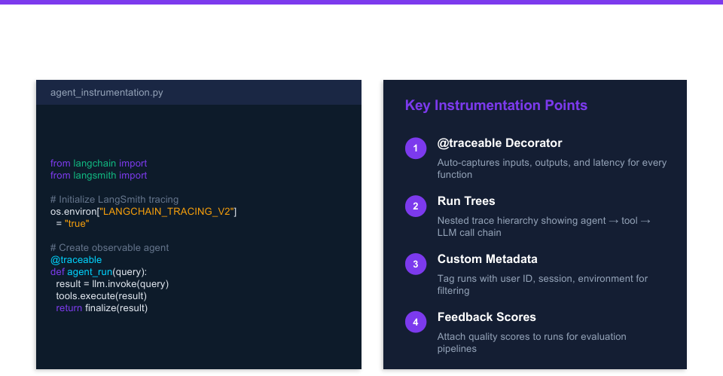

Slide 8

Tracing Failures & Root Cause Analysis
✓
✓
✓
✗
—
User Query
Agent
Planning
LLM Call
(GPT-4)
Tool:
DB Query
Response
Generation
→
→
→
→
Root Cause Identified
Failure Point
DB Query Tool — Timeout after 30s
Error Chain
Agent → LLM → Tool:db_query → ConnectionPool → TimeoutError
Impact
User query failed — no response generated
Owner
Backend / Database Team
Suggested Fix
Increase connection pool size, add retry logic with exponential backoff
Confidence
92% — based on 47 similar past incidents

Slide 9
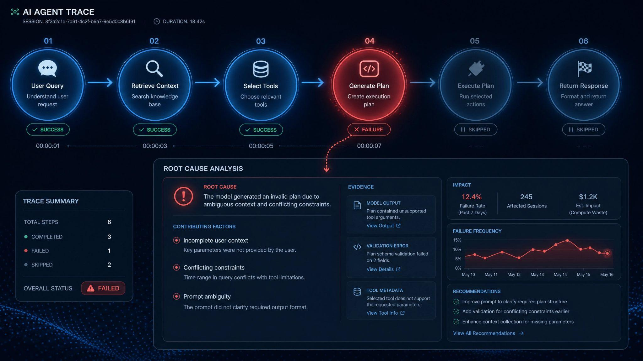

Slide 10


LangSmith: The Observability Backbone
Trace Visualization
Monitoring & Dashboards
Full execution tree — see every LLM call, tool use, and retrieval step with latency breakdown and input/output inspection
Track run metrics over time — latency percentiles, token costs, error rates, and success rates across agent versions
Evaluation & Testing
Prompt Engineering
Run automated evals on agent traces — compare outputs, measure quality, and catch regressions before deployment
Version, compare, and optimize prompts directly in LangSmith — playground for rapid iteration with live tracing

Slide 11

Building the AI Observability Agent
Core components that power the agentic observability system
Trace Ingestion
Layer
LangSmith webhook integration
Real-time trace streaming
Multi-agent trace correlation

Slide 12
Hands-On: Session Walkthrough
01
Setup & Instrument
Configure LangSmith, instrument a multi-tool agent with @traceable decorators
02
Run & Trace
Execute agent tasks, observe real-time trace capture in LangSmith dashboard
03
Inject Failures
Simulate tool timeouts, LLM hallucinations, and retrieval errors to test observability
04
Agent Diagnoses
The observability agent detects anomalies, traces root cause, and assigns ownership
05
Review & Iterate
Analyze incident reports, refine detection rules, and improve agent reliability

Slide 13
Key Takeaways
Observability is Evolving
AI agents need agent-native observability — traditional APM tools weren't built for non-deterministic systems
Agents Can Observe Agents
Use an AI agent to monitor, diagnose, and resolve failures in your other AI agents — observability goes agentic
LangSmith is the Foundation
End-to-end tracing, evaluation, and monitoring — the backbone for building observable agent systems
Ownership is Automatable
Map failures to teams automatically using trace analysis — reduce MTTR from hours to minutes

Slide 14
